Slide 1


ASSUIT UNIVERSITY
ELECTRIC FLUX, DISPLACEMENT, AND DIELECTRIC RESPONSE
By
JANA SAYED
MARIAM ABULMAWAHEB
FATMA ALZAHRAA IBRAHIM
MARIAM AHMED
LOJIEN DIAA

Slide 2
ASSUIT UNIVERSITY
Introduction
Objective
Research Questions
Literature Review
Electric field intensity
Polarization
The Electric Displacement Field
Current in a capacitor
Conclusion
OVERVIEW

Slide 3
ASSUIT UNIVERSITY
INTRODUCTION
Electric and electromagnetic phenomena govern the behavior of charges, fields, and materials under applied electric forces. The electric field describes how electric forces are transmitted through space, while electric flux provides a quantitative measure of field distribution and its relation to charge. When materials are exposed to electric fields, internal charge rearrangement leads to polarization, modifying the internal electric field and influencing the material response. Furthermore, time-varying electric fields play a crucial role in circuit and field theory, particularly in capacitors where Maxwell’s concept of displacement current ensures the consistency of electromagnetic laws. To accurately analyze electric fields in matter, the electric displacement field (D-field) is introduced to separate the effects of free charges from polarization-induced fields. This study presents a physical interpretation of these fundamental concepts and their interrelations.

Slide 4
OBJECTIVES
To explain the physical meaning of electric field force and its dependence on distance and area.
To understand why electric flux through a closed surface depends only on the enclosed charge.
To analyze polarization mechanisms and the formation of electric dipoles in materials.
To explain current behavior in capacitors under DC and AC conditions using Maxwell’s displacement current.
To define the electric displacement field and clarify the roles of external and internal electric fields in materials.

Slide 5
1
How does the electric field physically transmit force through space, and why does its intensity decrease with distance?
RESEARCH QUESTIONS
2
Why does the net electric flux through a closed surface equal the charge enclosed within it?
3
What physical mechanisms lead to the formation of different types of electric dipoles in materials?
4
Why is the D-field introduced, and how does it distinguish between external and internal electric fields in polarized materials?
5
How does a time-varying electric field allow current continuity in a capacitor through displacement current?

Slide 6
Literature Review
Theoretical Framework
Classical electromagnetics provides the foundation for understanding electric fields, forces, and flux, as discussed in standard textbooks such as University Physics by Young and Freedman and Introduction to Electrodynamics by Griffiths. Gauss’s law offers a physical interpretation of electric flux by relating it to enclosed charge through field-line concepts. Polarization and dipole formation in materials are extensively treated in Physics for Scientists and Engineers by Serway and Jewett, as well as materials science references. Maxwell’s introduction of displacement current resolved inconsistencies in Ampère’s law and is a cornerstone of electromagnetic theory, as described in classical texts. The electric displacement field and its role in separating free and bound charge effects are thoroughly analyzed in Electricity and Magnetism by Purcell and Classical Electrodynamics by Jackson.

Slide 7
1. ELECTRIC FIELD INTENSITY
By:
Jana Sayed

Slide 8
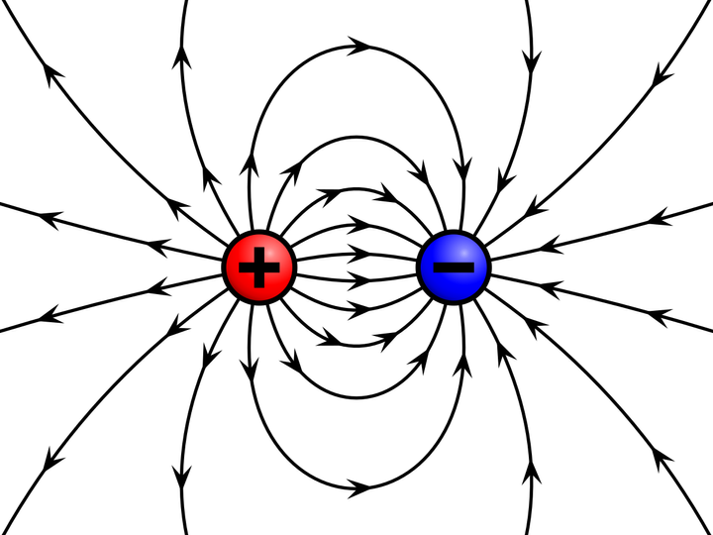
ELECTRIC FIELD AND ELECTRIC FORCE
ELECTRIC FIELD
An electric charge modifies the space around it. This modification is called the electric field.
When another charge is placed in this region, it experiences a force because it is interacting with that disturbed space.
Therefore, the electric field physically represents how strongly space pushes or pulls charges at a point, not just a mathematical quantity.

Slide 9


Slide 10
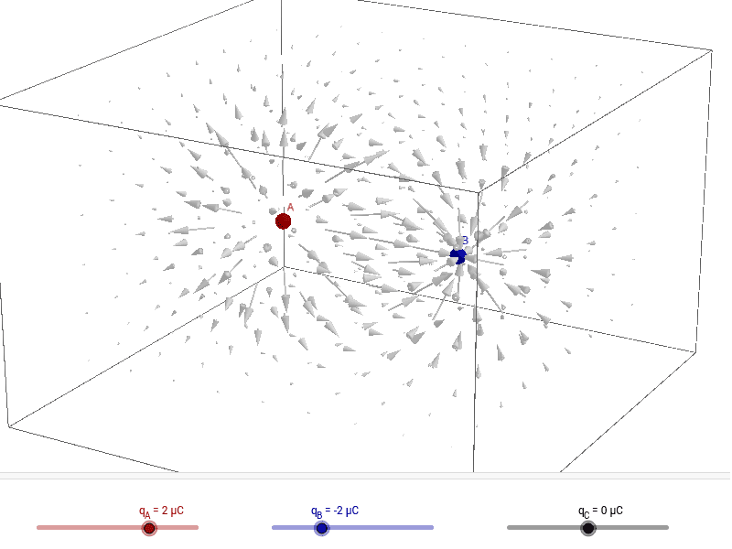

ELECTRIC FIELD AND DISTANCE
A point charge influences space in all directions equally. As distance increases, this influence spreads over a larger spherical area .
Since the total “effect” of the charge is the same, spreading it over a larger area makes the field weaker per unit area.
The Electric Field () from a point charge follows the Inverse Square Law.
Force: : $F=\frac{kq_{1 }q_{2}}{r^{2}}$
Intensity: $E=\frac{F}{q}=\frac{kq}{r^{2}}$
Proportionality: As the distance ($r$) doubles, the area of the imaginary sphere surrounding the charge increases by a factor of 4 ($A=4πr^{2}$), causing the field intensity to drop to 1/4.

Slide 11
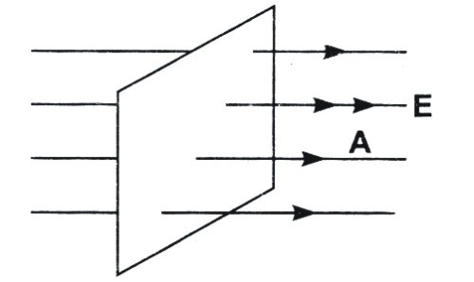

ELECTRIC FLUX
ELECTRIC FLUX
Electric flux measures how much electric field passes through a given surface.
It is proportional to both the field strength and the surface area because a stronger field or larger area allows more field lines to pass through.
ɸ $=BAcos(\text{θ})$
Where $\text{θ}$ between the normal to the surface and the magnetic field

Slide 12
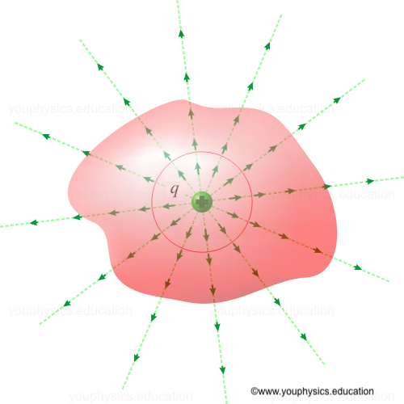
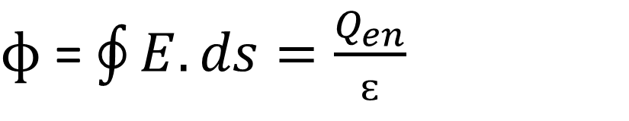
ELECTRIC FLUX
Electric charges are the sources and sinks of electric field lines.
For a closed surface, field lines created by charges outside the surface enter and leave in equal numbers, producing no net flux.
Only charges inside the surface generate field lines that begin or end within it, creating a net outward or inward flux.
Thus, total flux depends solely on the enclosed charge.
$ɸ$ = $\oint{E.ds=\frac{Q_{en}}{ɛ}}$

Slide 13
2.POLARIZATION :THE THREE TYPES OF DIPOLES
By:
Fatma Alzahraa Ibrahim

Slide 14
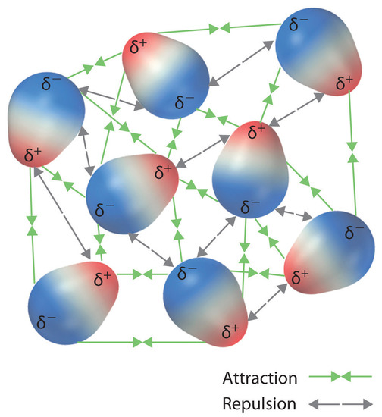

POLARIZATION
When a material is placed in an external electric field, internal charges slightly rearrange.
Positive and negative charges shift relative to each other, producing electric dipoles.
Polarization is therefore a microscopic charge displacement, not the movement of free charge.
$P=αɛ_{0}$E

Slide 16
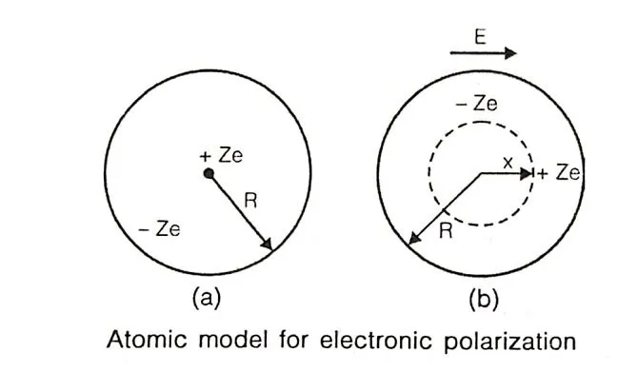
1.ELECTRONIC POLARIZATION
Electronic polarization is defined as an electric strain produced in an atom due to the application of an external electric field to the bulk material. It is the result of the displacement of the positively charged nucleus and the negative electrons of an atom in the opposite direction.

Slide 18
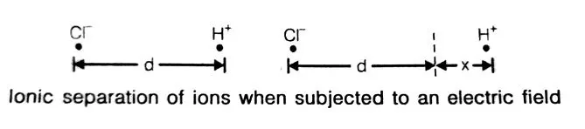
2.IONIC POLARIZATION
Ionic polarization is due to the displacement of cations and anions of an ionic solid subjected to the externally applied field.
Ionic polarization exists only for those types of materials that have a net positive charge and a net negative charge, even in the absence of an applied field. HCL molecules have a permanent dipole moment “e.d”, where d is the distance of separation of ions. In an electrical field, the resultant torque lines up the dipoles parallel to the field at absolute zero temperature.

Slide 20
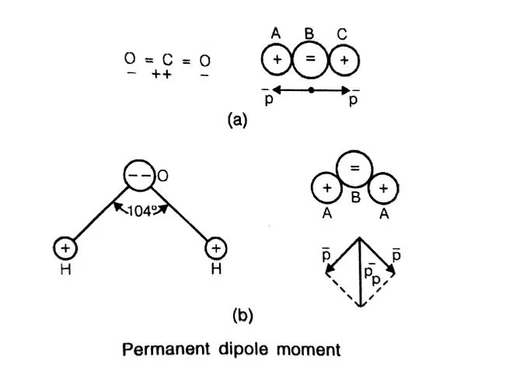
3.ORIENTATIONAL POLARIZATION
Orientational polarization is observed in the materials having a covalent bond of ionic character and molecules having a partial ionic bond.
The existence of a permanent moment is purely a matter of molecular geometry. Two hypothetical cases are shown in the figure . The molecules are of the form ABA. B atom i is negatively charged, whereas A’s are positively charged. The arrangements of the figure give a net-zero dipole moment in the absence of the field, whereas the molecular geometry of the figure gives a resultant dipole moment in the absence of the field. CO2 is an example of the first case and NO2, and H2O are examples of the second case.
Case Study

Slide 22
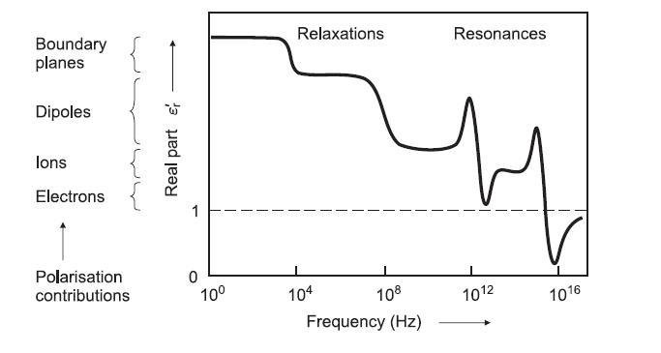
Polarization vs Frequency
The ability of a material to polarize depends strongly on the frequency of the applied electric field.
Low Frequencies (DC – kHz) All polarization mechanisms (electronic, ionic, orientation, interfacial) can follow the field variation. Polarization is maximum.
Medium Frequencies (MHz) Orientation polarization begins to lag due to molecular inertia and relaxation effects.
High Frequencies (GHz) Only fast mechanisms like electronic polarization can respond. Slower dipole rotations cannot keep up with the rapidly changing field.
Optical Frequencies Only electronic polarization remains effective.

Slide 23
3. THE ELECTRIC DISPLACEMENT FIELD (D)
By:
Lojien Diaa

Slide 24
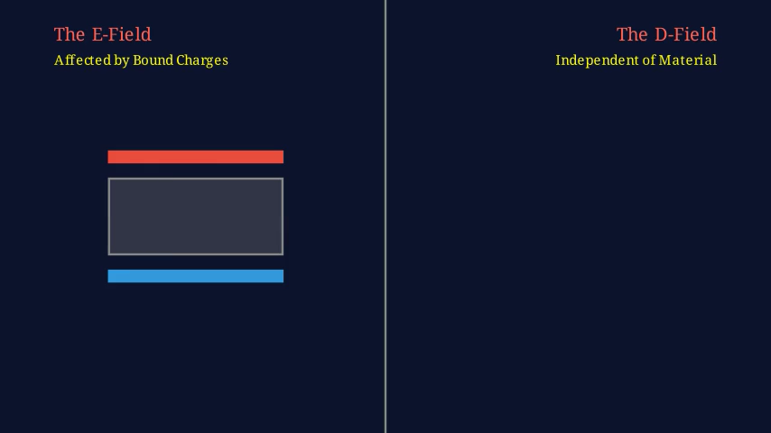

Slide 25
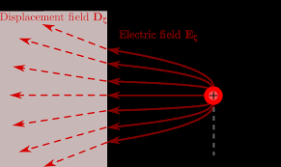

THE ELECTRIC DISPLACEMENT FIELD (D)
The D-field represents the electric field contribution caused only by free charges, excluding the effect of polarization inside the material. It allows us to treat complex material responses separately from external charge sources.
Mathematically, it is defined as:
$$D=ε_{0}E+P$$
where:
$ɛ_{0}E$the total electric field
$P$the polarization vector
Physically, D is not a real force field like E, but a useful construct that simplifies Maxwell’s equations in matter.

Slide 27
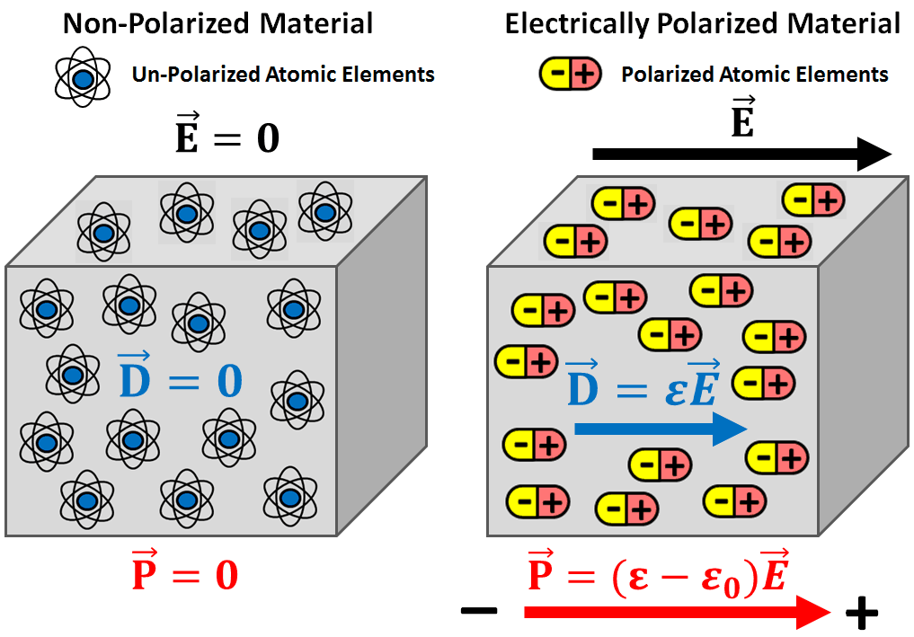
THE ELECTRIC DISPLACEMENT FIELD (D)
When a dielectric material is placed in an external electric field, the field causes polarization inside the material. This polarization creates bound charges on the surfaces of the dielectric, which in turn generate an internal electric field that opposes the applied external field.
As a result, the total electric field inside the material becomes difficult to analyze because it is the combination of:
The field due to free charges
The field due to bound (polarization) charges
To simplify this problem, the electric displacement field (D) is introduced.

Slide 28
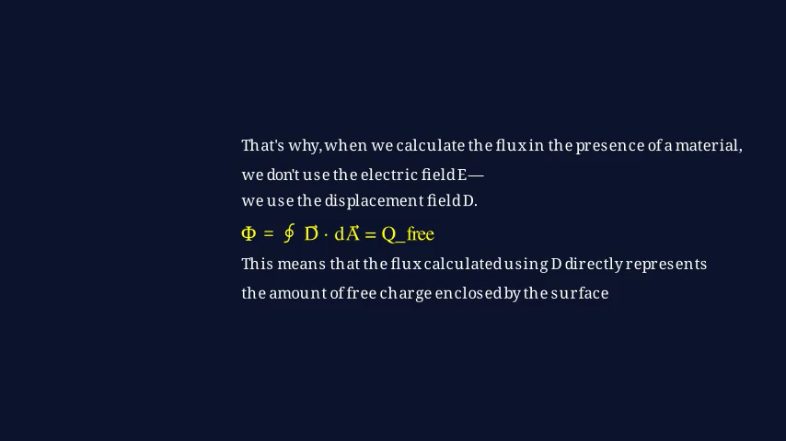

Slide 29
4.CURRENT IN A CAPACITOR: MAXWELL’S DISPLACEMENT CURRENT
By:
Mariam Abulmawaheb

Slide 31
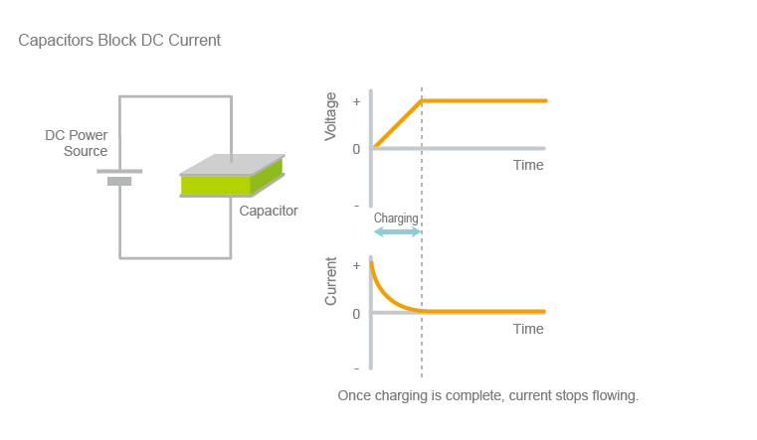
THE DC VS. AC PARADOX
DC
When a capacitor is connected to a DC source, current initially flows as the capacitor begins to charge. Electrons accumulate on one plate while an equal amount of charge is removed from the other plate, creating an electric field between the plates. As charging continues, the voltage across the capacitor increases and opposes the applied voltage, causing the current to gradually decrease. Once the capacitor is fully charged, the electric field becomes constant, and no further current flows through the circuit. At this steady state, the capacitor behaves like an open circuit for DC signals.
the plates constantly charge and discharge. While no electrons cross the gap, the changing electric field allows the circuit to behave as if current is flowing through the capacitor.
A capacitor acts as an open circuit. Charge builds up on the plates until the voltage matches the source, then the flow stops. No "actual" electrons cross the gap.

Slide 32
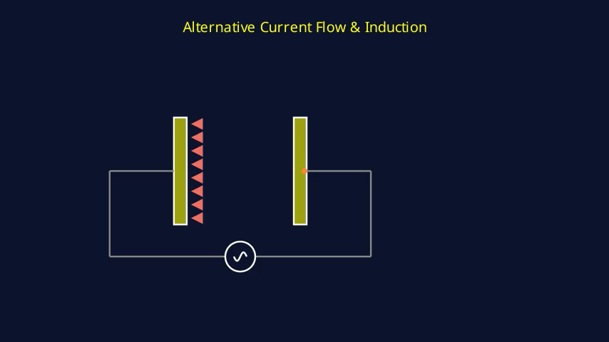

Slide 33
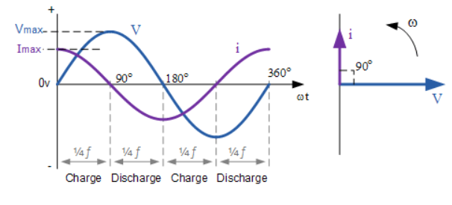
THE DC VS. AC PARADOX
AC
In an AC circuit, the applied voltage continuously changes with time, causing the capacitor to repeatedly charge and discharge. Although no actual charge crosses the dielectric between the plates, a current appears to flow in the external circuit. This happens because the electric field between the plates is constantly changing. As the frequency of the AC signal increases, the capacitor charges and discharges more rapidly, allowing more current to flow. Therefore, a capacitor offers less opposition to high-frequency signals and more opposition to low-frequency signals

Slide 34
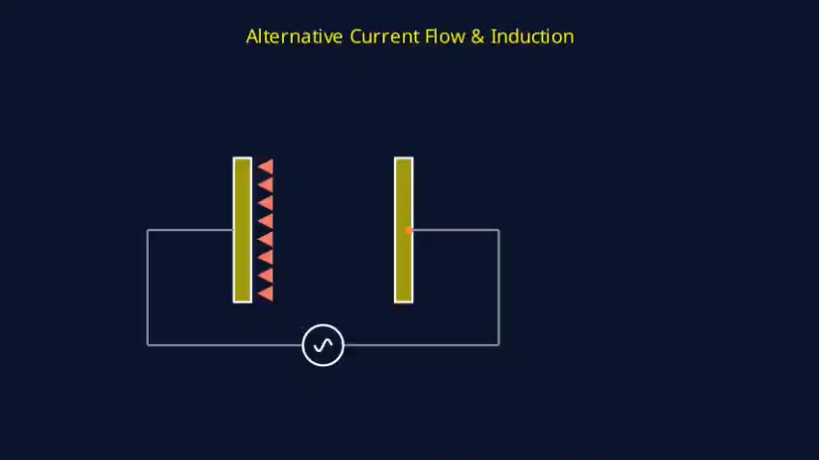

Slide 35
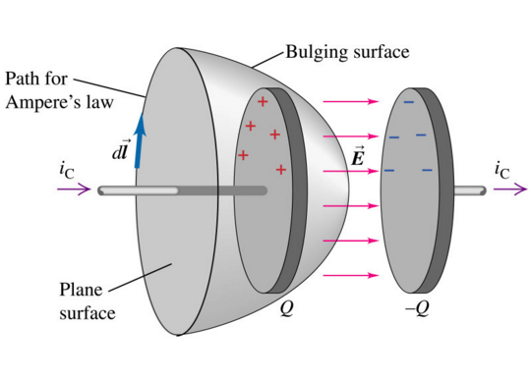
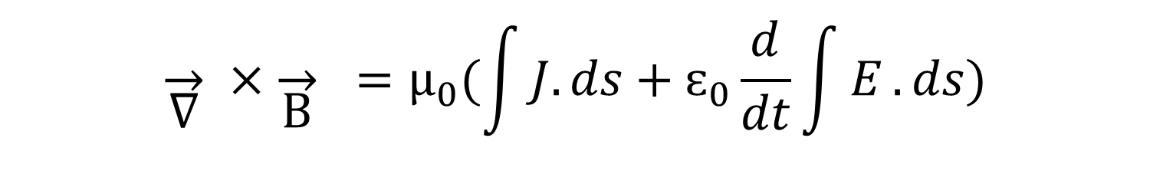

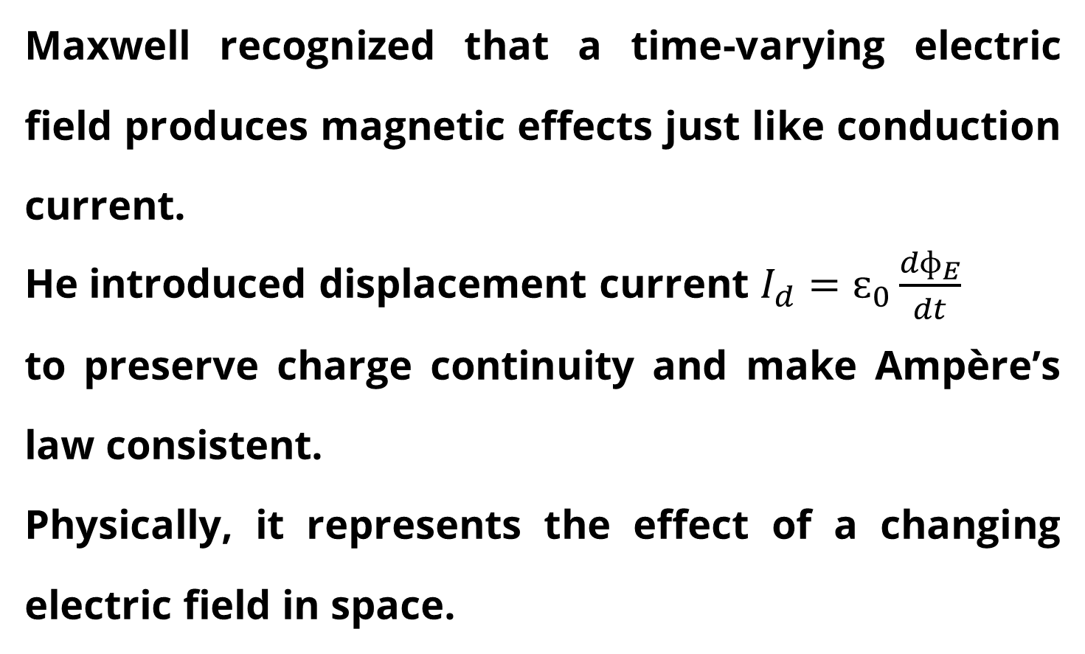

DISPLACEMENT CURRENT ($I_{d}$)
Maxwell recognized that a time-varying electric field produces magnetic effects just like conduction current.
He introduced displacement current $I_{d}=ɛ_{0}\frac{{dɸ}_{E}}{dt}$
to preserve charge continuity and make Ampère’s law consistent.
Physically, it represents the effect of a changing electric field in space.
$$\overset{→}{\text{∇}} ×\overset{→}{\text{B}} =μ_{0}(\int{J.ds}+ɛ_{0}\frac{d}{dt}\int{E}.ds)$$
$$\oint{B.dl=μ_{0}(J+ɛ_{0}\frac{δE}{δt})}$$

Slide 36
ASSUIT UNIVERSITY
CONCLUSION
This study presented a physical interpretation of fundamental electric field concepts, including electric force, flux, polarization, capacitor behavior, and the electric displacement field. By examining how electric fields interact with space, charges, and materials, the role of polarization and displacement current in maintaining electromagnetic consistency was clarified. Understanding these principles provides a strong foundation for analyzing electric fields in matter, dielectric materials, and time-varying electromagnetic systems.
Project files and code are available at:
https://github.com/471020155/manim-project_group-5.git

Slide 37
THANK YOU
FOR THE ATTENTION
Presentation By : Mariam Ahmed

